Slide 1



Team Netaverse
Nov. 6, 2021
Team Netaverse
Notes:
Feedback
Who’s paying for it needs to be more clear
Give an example: what kinds of education do nurses want?
Potential for users to access worldwide education
The story should be: hired 25 nurses, 6 months later only 8 left
We would save hospitals money: cost $100,000 per new nurse orientation
Ease the workloads of nurse educators, who are also burning out
Push your problem statement towards your innovation, maybe 1 slide at the end of WHO each on your teams is, watch out on using acronyms
We’re tapping into the human aspect (what people actually want), not a curriculum
This would be one of our most powerful insights
Changing curriculum development, it’ll be based on what NURSES want to learn to help them perform their jobs better → could even do a RCT
We can broker what people need and deliver it to a customer that would pay, that’s the value
Distribution:
Set up these centres in nursing schools or hospitals? Check out headsets like a library system?
Callie recommends a content first approach
What are the moments in the scenario that we would want to be trained in?
What value is our content providing that saves customers time and/or money?
The bonus would be the value that adds to the nurses
What do we need the VR to do and why?
6 degrees of freedom: built on a physics engine (i.e. objects would fall, simulating reality still)
> $300k, but it’s easier if you have assets in place (e.g. patient, room, etc.)
But changing the environment requires diff builds
There are grants
How many sessions would it take to master a skill?
Efficacy of XR training is not new, but what is new is content driven by nurses

Slide 2
The Problem
Everyone loves to hear stories. So tell an exciting story about your idea!

Slide 3
Pitch Presentation Components

Slide 4
Pitch Presentation Components
Problem Articulation
Current Available Solutions
Your Solution (MVP)
Implementation Cost
Scalability
The Team & Close
Questions
‹#›
Notes:
Create education for nurses by nurses
content library: open marketplace, curated, diff XR companies can create XR training simulations based on what nurses are requesting
Nurse profile application: fill out what background they have, keystones they’ve been missing

Slide 5
The Problem
WHAT IS THE PROBLEM OR UNMET NEED YOU ARE SOLVING?
How you describe the problem is one of the most important components to a pitch. Tell us the problem through storytelling. Bring the audience straight into the story.
Talk about the problem that generated your idea, what motivated your project, and how it is part of your life and/or your group’s. This kind of information generates empathy and is the first step to grab their attention
Don’t assume we know anything, even if we are all nurses. Explain the problem in detail, step by step.
What is the problem/pain point you are trying to address? What does it cause? Who feels the pain point?
Engage and draw the audience in and make them feel like they are solving the problem with you.
HOW BIG IS THIS PROBLEM (Scope)? HOW MANY PEOPLE DOES IT AFFECT?
Data helps here if you can find the right information.
Example: if I am going to tell the audience about the problem with patient falls, I would want to let them know the volume of hospital falls costs $53 Billion dollars/year nationally.
‹#›
Notes:
New grads don’t have enough practical time / training to prepare them for the job
Few solutions but no one-stop shop for nursing education developed by nurses
I am a nurse trying to gain practical ICU RN skills
I’m trying to build up my clinical competence and critical thinking skills so I can feel confident handling real-life patient scenarios
But it is difficult to gain hands-on and relevant experience
Because of inadequate/insufficient methods of providing clinical experience in orientation or online
Which makes me feel frustrated, concerned, and stressed

Slide 6


The Problem
Team Netaverse
New graduate and newly transferred nurses feel unprepared, causing burnout
Onboarding currently costs $100,000 and 89 days to fill a role
‹#›
Notes:
New grads don’t have enough practical time / training to prepare them for the job
Few solutions but no one-stop shop for nursing education developed by nurses
I am a nurse trying to gain practical ICU RN skills
I’m trying to build up my clinical competence and critical thinking skills so they can feel confident handling real-life patient scenarios
But it is difficult to gain hands-on and relevant experience
Because of inadequate methods of providing clinical experience in orientation (ie. Slides or online videos)
Which makes me feel frustrated and concerned and stressed
quit after 89 days in role

Slide 7
The Problem
Team Netaverse
Lack of a one-stop shop for nursing education developed by nurses
‹#›
Notes:
New grads don’t have enough practical time / training to prepare them for the job
Few solutions but no one-stop shop for nursing education developed by nurses
I am a nurse trying to gain practical ICU RN skills
I’m trying to build up my clinical competence and critical thinking skills so they can feel confident handling real-life patient scenarios
But it is difficult to gain hands-on and relevant experience
Because of inadequate methods of providing clinical experience in orientation (ie. Slides or online videos)
Which makes me feel frustrated and concerned and stressed
quit after 89 days in role

Slide 8






Meet The Team
Team Netaverse
Joanna Getek
Registered Nurse
joannagetek@gmail.com
LinkedIn: joannagetek
Zayn Khamis
Healthcare Advocate
zaynkhamis@msn.com
LinkedIn: zaynkhamis
Ben Smieja
Developer
benstils@gmail.com
LinkedIn: Ben Smieja
Dimuth Kurukula
Developer
dimuthkurukula@gmail.com
GitHub: dkurukula
Joey Lee
Registered Nurse and Operational Readiness Specialist
joeylee668@gmail.com
LinkedIn: joeycylee
Github: joeycylee
‹#›

Slide 9


Our Solution: Netaverse
Team Netaverse
Nurse-driven education
Online marketplace that will allow:
Nurses and educators to submit requests for specific extended reality (XR) and interactive content to be made
Content creators (individuals or companies) to fill the above requests
Nurses to access content to develop their skills and confidence
‹#›
Notes:
Nurse-driven education = based on what nurses believe they need to help them perform their jobs better
content library: open marketplace, curated, diff XR companies can create XR training simulations based on what nurses are requesting
Nurse profile application: fill out what background they have, keystones they’ve been missing
Use hospital-specific equipment in the scenarios
We’re tapping into the human aspect (what people actually want), not a curriculum
This would be one of our most powerful insights
Changing curriculum development, it’ll be based on what NURSES want to learn to help them perform their jobs better → could even do a RCT
We can broker what people need and deliver it to a customer that would pay, that’s the value
Distribution:
Set up these centres in nursing schools or hospitals? Check out headsets like a library system?
Callie recommends a content first approach
What are the moments in the scenario that we would want to be trained in?
What value is our content providing that saves customers time and/or money?
The bonus would be the value that adds to the nurses
What do we need the VR to do and why?
6 degrees of freedom: built on a physics engine (i.e. objects would fall, simulating reality still)
> $300k, but it’s easier if you have assets in place (e.g. patient, room, etc.)
But changing the environment requires diff builds
There are grants
How many sessions would it take to master a skill?
Efficacy of XR training is not new, but what is new is content driven by nurses
Create education for nurses by nurses
content library: open marketplace, curated, diff XR companies can create XR training simulations based on what nurses are requesting
Nurse profile application: fill out what background they have, keystones they’ve been missing
Emphasize the focus on nurses → why is this important?

Slide 10

Our Solution: Netaverse
Team Netaverse
Best in-class education for ALL nurses
Global access
‹#›
Notes:
Nurse-driven education = based on what nurses believe they need to help them perform their jobs better
content library: open marketplace, curated, diff XR companies can create XR training simulations based on what nurses are requesting
Nurse profile application: fill out what background they have, keystones they’ve been missing
Use hospital-specific equipment in the scenarios
We’re tapping into the human aspect (what people actually want), not a curriculum
This would be one of our most powerful insights
Changing curriculum development, it’ll be based on what NURSES want to learn to help them perform their jobs better → could even do a RCT
We can broker what people need and deliver it to a customer that would pay, that’s the value
Distribution:
Set up these centres in nursing schools or hospitals? Check out headsets like a library system?
Callie recommends a content first approach
What are the moments in the scenario that we would want to be trained in?
What value is our content providing that saves customers time and/or money?
The bonus would be the value that adds to the nurses
What do we need the VR to do and why?
6 degrees of freedom: built on a physics engine (i.e. objects would fall, simulating reality still)
> $300k, but it’s easier if you have assets in place (e.g. patient, room, etc.)
But changing the environment requires diff builds
There are grants
How many sessions would it take to master a skill?
Efficacy of XR training is not new, but what is new is content driven by nurses
Create education for nurses by nurses
content library: open marketplace, curated, diff XR companies can create XR training simulations based on what nurses are requesting
Nurse profile application: fill out what background they have, keystones they’ve been missing
Emphasize the focus on nurses → why is this important?

Slide 11
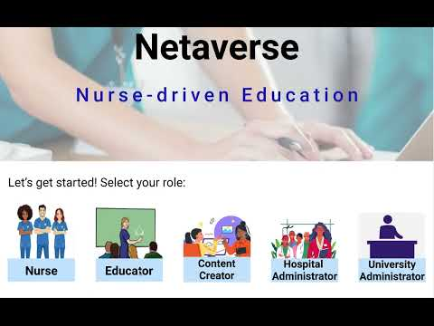
‹#›
Notes:
Nurse-driven education = based on what nurses believe they need to help them perform their jobs better
content library: open marketplace, curated, diff XR companies can create XR training simulations based on what nurses are requesting
Nurse profile application: fill out what background they have, keystones they’ve been missing
Use hospital-specific equipment in the scenarios
We’re tapping into the human aspect (what people actually want), not a curriculum
This would be one of our most powerful insights
Changing curriculum development, it’ll be based on what NURSES want to learn to help them perform their jobs better → could even do a RCT
We can broker what people need and deliver it to a customer that would pay, that’s the value
Distribution:
Set up these centres in nursing schools or hospitals? Check out headsets like a library system?
Callie recommends a content first approach
What are the moments in the scenario that we would want to be trained in?
What value is our content providing that saves customers time and/or money?
The bonus would be the value that adds to the nurses
What do we need the VR to do and why?
6 degrees of freedom: built on a physics engine (i.e. objects would fall, simulating reality still)
> $300k, but it’s easier if you have assets in place (e.g. patient, room, etc.)
But changing the environment requires diff builds
There are grants
How many sessions would it take to master a skill?
Efficacy of XR training is not new, but what is new is content driven by nurses
Create education for nurses by nurses
content library: open marketplace, curated, diff XR companies can create XR training simulations based on what nurses are requesting
Nurse profile application: fill out what background they have, keystones they’ve been missing
Emphasize the focus on nurses → why is this important?

Slide 12

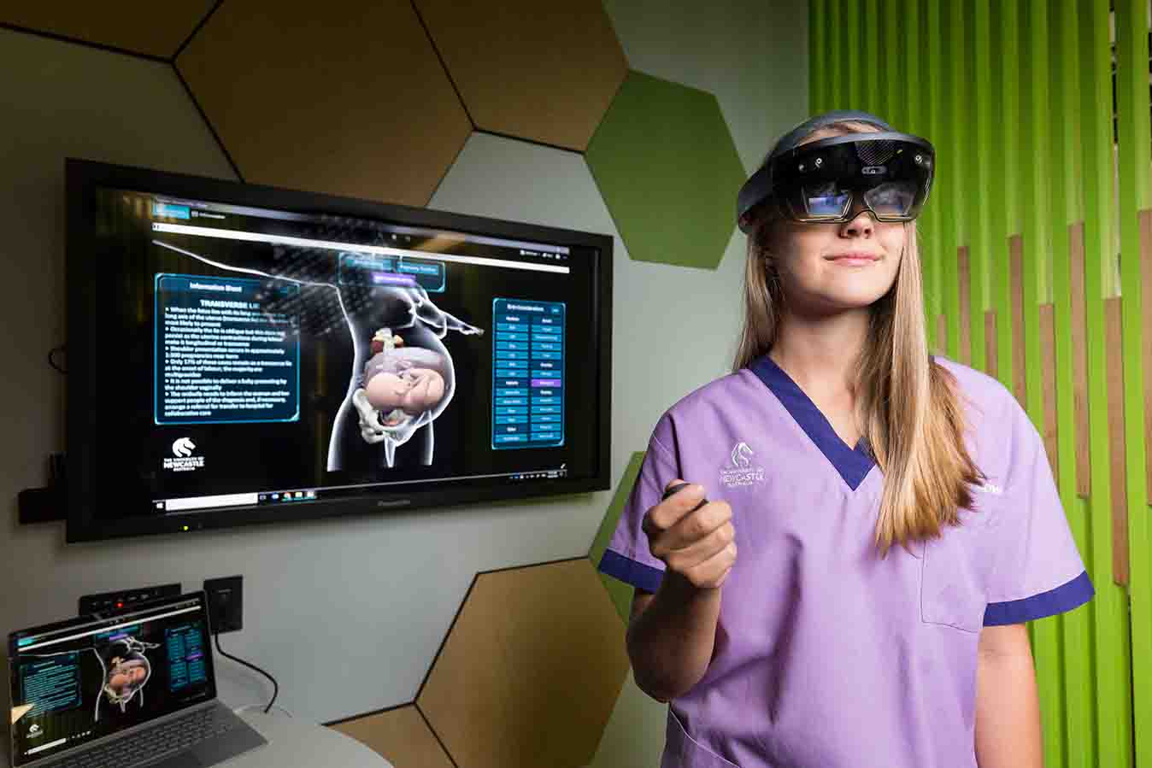



Currently Available Solutions
Team Netaverse
Top down curricula
‹#›
Notes:
Online modules/slides, in class lab simulations, online simulations (American Heart Association has one for ACLS- but not modifiable/customizable)
Axon park, embodied labs
SIMX? UbiSim?

Slide 13
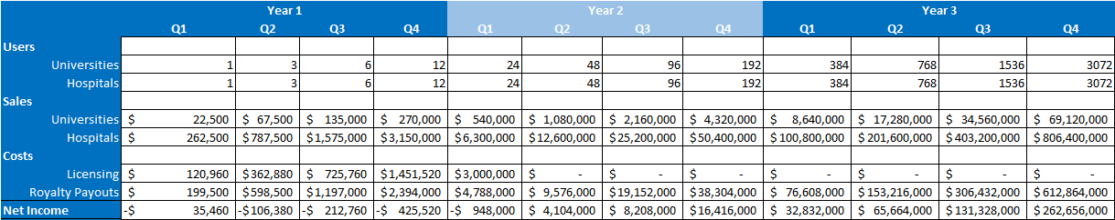
Financials
Team Netaverse
Hospitals and universities will pay per user subscription costs
Subscription costs will result in cost savings for hospitals
Content creators will get 70% of subscription revenue
‹#›
Notes:
Nurse-driven education = based on what nurses believe they need to help them perform their jobs better
content library: open marketplace, curated, diff XR companies can create XR training simulations based on what nurses are requesting
Nurse profile application: fill out what background they have, keystones they’ve been missing
Use hospital-specific equipment in the scenarios
We’re tapping into the human aspect (what people actually want), not a curriculum
This would be one of our most powerful insights
Changing curriculum development, it’ll be based on what NURSES want to learn to help them perform their jobs better → could even do a RCT
We can broker what people need and deliver it to a customer that would pay, that’s the value
Distribution:
Set up these centres in nursing schools or hospitals? Check out headsets like a library system?
Callie recommends a content first approach
What are the moments in the scenario that we would want to be trained in?
What value is our content providing that saves customers time and/or money?
The bonus would be the value that adds to the nurses
What do we need the VR to do and why?
6 degrees of freedom: built on a physics engine (i.e. objects would fall, simulating reality still)
> $300k, but it’s easier if you have assets in place (e.g. patient, room, etc.)
But changing the environment requires diff builds
There are grants
How many sessions would it take to master a skill?
Efficacy of XR training is not new, but what is new is content driven by nurses
Create education for nurses by nurses
content library: open marketplace, curated, diff XR companies can create XR training simulations based on what nurses are requesting
Nurse profile application: fill out what background they have, keystones they’ve been missing
Emphasize the focus on nurses → why is this important?

Slide 14
Team Netaverse
Nov. 6, 2021
Team Netaverse
Notes:
Feedback
Who’s paying for it needs to be more clear
Give an example: what kinds of education do nurses want?
Potential for users to access worldwide education
The story should be: hired 25 nurses, 6 months later only 8 left
We would save hospitals money: cost $100,000 per new nurse orientation
Ease the workloads of nurse educators, who are also burning out
Push your problem statement towards your innovation, maybe 1 slide at the end of WHO each on your teams is, watch out on using acronyms
We’re tapping into the human aspect (what people actually want), not a curriculum
This would be one of our most powerful insights
Changing curriculum development, it’ll be based on what NURSES want to learn to help them perform their jobs better → could even do a RCT
We can broker what people need and deliver it to a customer that would pay, that’s the value
Distribution:
Set up these centres in nursing schools or hospitals? Check out headsets like a library system?
Callie recommends a content first approach
What are the moments in the scenario that we would want to be trained in?
What value is our content providing that saves customers time and/or money?
The bonus would be the value that adds to the nurses
What do we need the VR to do and why?
6 degrees of freedom: built on a physics engine (i.e. objects would fall, simulating reality still)
> $300k, but it’s easier if you have assets in place (e.g. patient, room, etc.)
But changing the environment requires diff builds
There are grants
How many sessions would it take to master a skill?
Efficacy of XR training is not new, but what is new is content driven by nurses

Slide 15
EXAMPLE 1 – Our Solution vs. The Competition
Benefits | Our Solution | Competitor 1 | Competitor 2 | Competitor 3 | Competitor 4
Intuitive to Use | X
Cost to Use | Free | $X Subscription
Platform | Microsoft | Zoom
Users | Patients/Families/ Clinicians | Clinicians only
‹#›

Slide 16
EXAMPLE 2 – Our Solution vs. The Competition
Benefits | Our Solution | Competitor 1 | Competitor 2 | Competitor 3 | Competitor 4
Intuitive Design
Cost
Performance
Quality
Complexity
Overall Assessment | 5 | 3 | 2 | 2 | 1
‹#›

Slide 17


Implementation Cost
Team Netaverse
Startup
License core material
Start aggregating requests
Subscription-based
‹#›
Notes:
Pluralsight, like LinkedIn Learning, is subscription-based. Business subscriptions for skills may cost $579 or $779 per student per year, depending on how many features a subscriber prefers.

Slide 18


Scalability
Team Netaverse
Scale
Content creators create based on requests → content library grows
Growth
Buy out core material
Money from subscriptions (institutions) goes 30% to us, 70% to creators
‹#›
Notes:
Can expand to med schools and other allied health
Global education for nurses

Slide 19
The Team & Close
Bring the story you opened with full circle.
Close the pitch– why do you think this is a great idea? Remind the audience what they have seen
– no more than three points.
Introduce your team members and discuss skill sets brought to the team that strengthens the solution. By now the audience understands your proposed solution so they can connect the skill sets. Include contact Info: Name/Email
Many investors will invest if they like the team and find the team inspiring and passionate.
Try to anticipate the judges questions so you can answer them, however, if you have done your homework, you will be prepared.
Finally, practice, practice, practice! Getting all important points across in 3 minutes!
‹#›

Slide 20
Additional charts, process, timeline templates
Use if helpful

Slide 21
Slide Title in Arial Bold, 30 pt. Black
Subtitle in Arial Regular, 20 pt.
Use this template for two columns of text, two images, or to pair text with a cropped image. If there is only one chunk of copy, consider getting rid of the bullets.

Slide 22
Slide Title in Arial Bold, 30 pt. Black
Subtitle in Arial Regular, 20 pt.
In some cases, the image will sit to the left of the text.
Make sure whichever you choose, it is consistent throughout your presentation.

Slide 23
Slide Title in Arial Bold, 30 pt. Black
Subtitle in Arial Regular, 20 pt.
Bulleted copy spans two columns, to the right of a single-column image.
In this scenario, image should usually be on the left.

Slide 24
Slide Title in Arial Bold, 30 pt. Black
Subtitle in Arial Regular, 20 pt.
Three columns of text
or text with imagery
or just images

Slide 25
Slide Title in Arial Bold, 30 pt. Black
Subtitle in Arial Regular, 20 pt.
Three columns of text
or text with imagery
or just images

Slide 26
“Use this template
to add extra emphasis to a quote, fact
or statistic.”
– Attribution

Slide 27
“Use this template
to add extra emphasis to a quote, fact
or statistic.”
– Attribution

Slide 28
“Use this template
to add extra emphasis to a quote, fact
or statistic.”
– Attribution

Slide 29
Bar Chart Example
Extending past 6 colors
Manually select colors from palette to complete the chart.
0%
10%
20%
30%
40%
50%
60%
70%
80%
When using bar charts, retain a minimum distance of 50% between data points.
USA
Canada Australia France Korea Brazil Sweden Chile
Series 1

Slide 30
Stacked Column Example
Align elements to the grid and enhance the size of key.
% to Sales
2006 25.7%
2007 26.0%
$14.6B |  | $15.9B
$5.7 |  | $6.0
$6.9 |  | $7.6
$2.0 |  | $2.3
2006 |  | 2007
MD&D
Consumer Pharmaceuticals

Slide 31
Compare/Contrast Example
Subhead
Your body copy goes here. Body copy goes here. Body copy goes here. Body copy goes here.
1 in 5
Describe your statistic here. This is where the text goes, in Arial 15pt font.
Subhead
Your body copy goes here. Body copy goes here. Body copy goes here. Body copy goes here.
3 in 5
Describe your statistic here. This is where the text goes, in Arial15pt font.
22%
Your content relating to the pie chart can go here.
31%
Your content relating to the pie chart can go here.
Subhead
Subhead
Your first bullet point can go here.
This is where your second bullet point will go.
Your first bullet point can go here.
This is where your second bullet point will go.

Slide 32
4 Column Organization
Subhead1
Put your body copy for subhead one here. You can divide into paragraphs, if needed. This is where the body copy goes. This is where the body copy goes. This is where the body copy goes.
Subhead 2
Put your body copy for subhead one here. You can divide into paragraphs, if needed.
Subhead 3
Put your body copy for subhead one here. You can divide into paragraphs, if needed. This is where the body copy goes. This is where the body copy goes. This is where the body copy goes. This is where the body copy goes. This is where the body copy goes. This is where the body copy goes.
Subhead 4
Put your body copy for subhead one here. You can divide into paragraphs, if needed. This is where the body copy goes. This is where the body copy goes.

Slide 33
Pyramid Example
Subtitle in Arial Regular, 20 pt.
Manually select colors from palette to complete the chart. Include any explanatory information here.
Level 5
Your Content Here
Level 4
Your Content Here
Level 3
Your Content Here
Level 2
Your Content Here
Level 1
Your Content Here

Slide 34


Name Lastname
Title
Write a short biography here…

Slide 35
Timeline
 | August |  |  |  | September |  |  |  | October
 | Week 1 | Week 2 | Week 3 | Week 4 | Week 1 | Week 2 | Week 3 | Week 4 | Week 1 | Week 2 | Week 3 | Week 4
Task Title 1
Task Title 2 |  | Milestone
Task Title 3
Task Title 4 |  |  |  |  | Milestone
Task Title 5
Task Title 6
Task Title 7 |  |  |  |  |  |  | Milestone
Task Title 8 |  |  |  |  |  |  |  |  |  |  | Milestone
‹#›

Slide 36
Timeline Overview
Phase 1
Description
Phase 2
Description
Phase 3
Description
Phase 4
Description
Deliverable 1 Additional info
Deliverable 2 Additional info
Deliverable 3 Additional info
Deliverable 4 Additional info
‹#›

Slide 37
Venn Diagram
Topic 1
Topic 3
Topic 2
Text goes here
Text goes here
Text goes here
Text goes here
Text goes here
Text goes here
Text goes here
Text goes here
Text goes here
‹#›

Slide 38
Process Map
Activity name
Activity name
Activity name
Phase 1
Activity name
Phase 2
Activity name
Activity name
Phase 3
Activity name
Activity name
Activity name
‹#›

Slide 39


Organizational Chart
Name Lastname
Title Description here…
Name Lastname
Title Description here…
Name Lastname
Title Description here…
Name Lastname
Title Description here…
Name Lastname
Title Description here…
Name Lastname
Title Description here…
Name Lastname
Title Description here…
Name Lastname
Title Description here…
Name Lastname
Title Description here…
Name Lastname
Title Description here…
Name Lastname
Title Description here…
Name Lastname
Title Description here…
Name Lastname
Title Description here…
‹#›

Slide 40
Table Example A
Use solid colors headers and row color variations to separate information. Change table colors using the Table Design tab.
TOTAL COMPANY | 2010 | 2009 | % CHANGE
 |  |  | TOTAL | OPS
Sales | $61.6B | $61.9B | (0.5%) | (1.3%)
Adjusted Earnings* | $13.3B | $12.9B | 2.9%
Adjusted EPS* | $4.76 | $4.63 | 2.8%
Free Cash Flow** | $14.0B | $14.2B
‹#›

Slide 41
Table Example B
Use solid colors headers and row color variations to separate information. Change table colors using the Table Design tab.
TOTAL COMPANY | 2010 | 2009 | % CHANGE
 |  |  | TOTAL | OPS
Sales | $61.6B | $61.9B | (0.5%) | (1.3%)
Adjusted Earnings* | $13.3B | $12.9B | 2.9%
Adjusted EPS* | $4.76 | $4.63 | 2.8%
Free Cash Flow** | $14.0B | $14.2B
‹#›

